Slide 1

FidMark: A Fiducial Marker Ontology For Semantically Describing Visual Markers
Maxim Van de Wynckel, Isaac Valadez, Beat Signer
Notes:
Hello, my name is Maxim Van de Wynckel; I am a PhD candidate at the Vrije Universiteit Brussel and today I will be presenting our fiducial marker ontology for semantically describing visual markers, named FidMark.

Slide 2
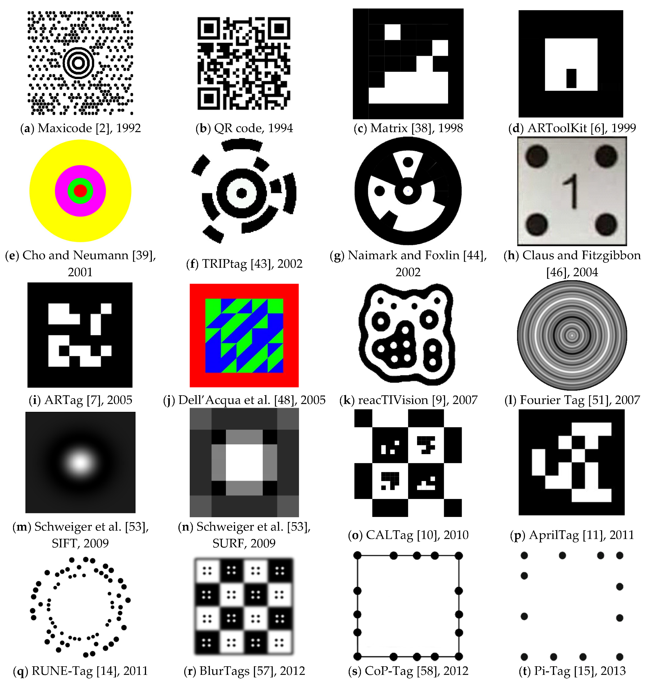
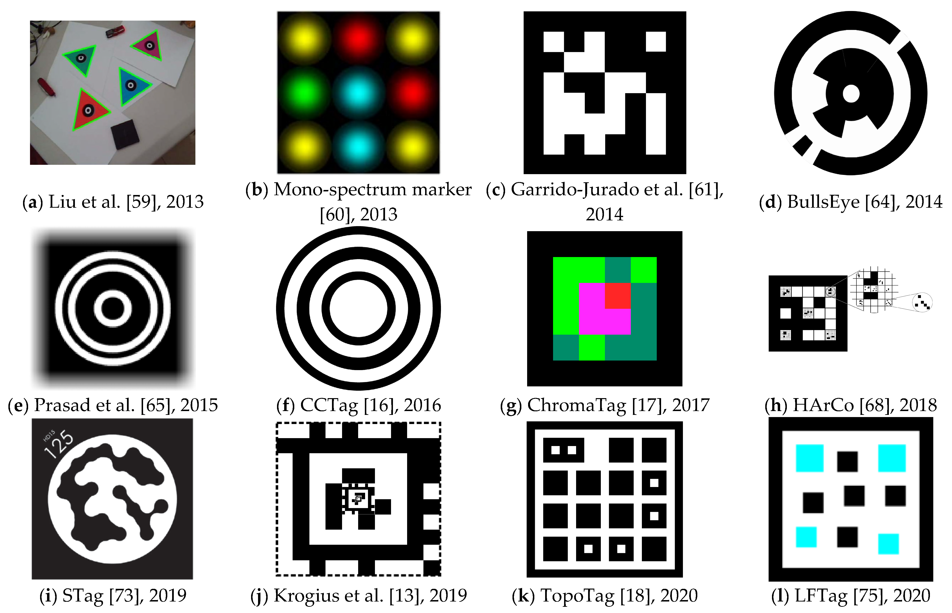
Background – Fiducial Marker
Košťák, M.; Slabý, A. Designing a Simple Fiducial Marker for Localization in Spatial Scenes Using Neural Networks. Sensors 2021, 21, 5407. https://doi.org/10.3390/s21165407
Notes:
To start off with some background, a fiducial marker is

Slide 3
Design Goals
DG1 Retrieve a list of supported markers
DG2 Retrieve markers using the identifiable information
DG3 Describe markers with a non-standard symbology
DG4 Enable pose estimation of markers
DG5 Enable relative positioning of objects to markers
DG6 Enable markers as engineering reference frames
DG7 Facilitate the integration in CV frameworks

Slide 4
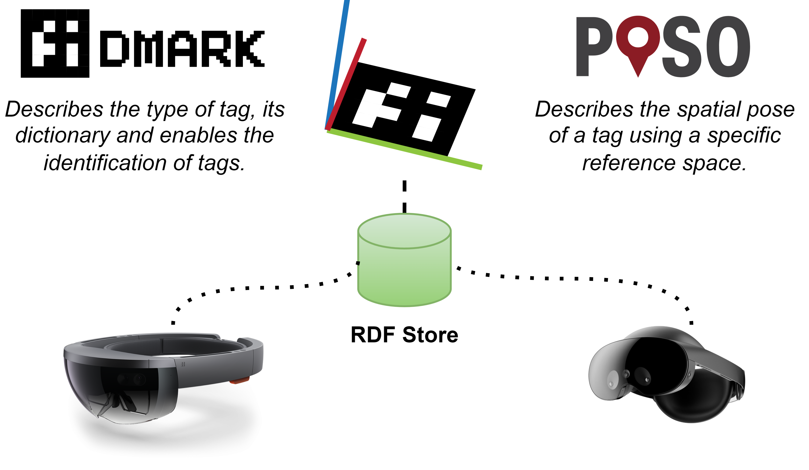
Ontology Design

Slide 5
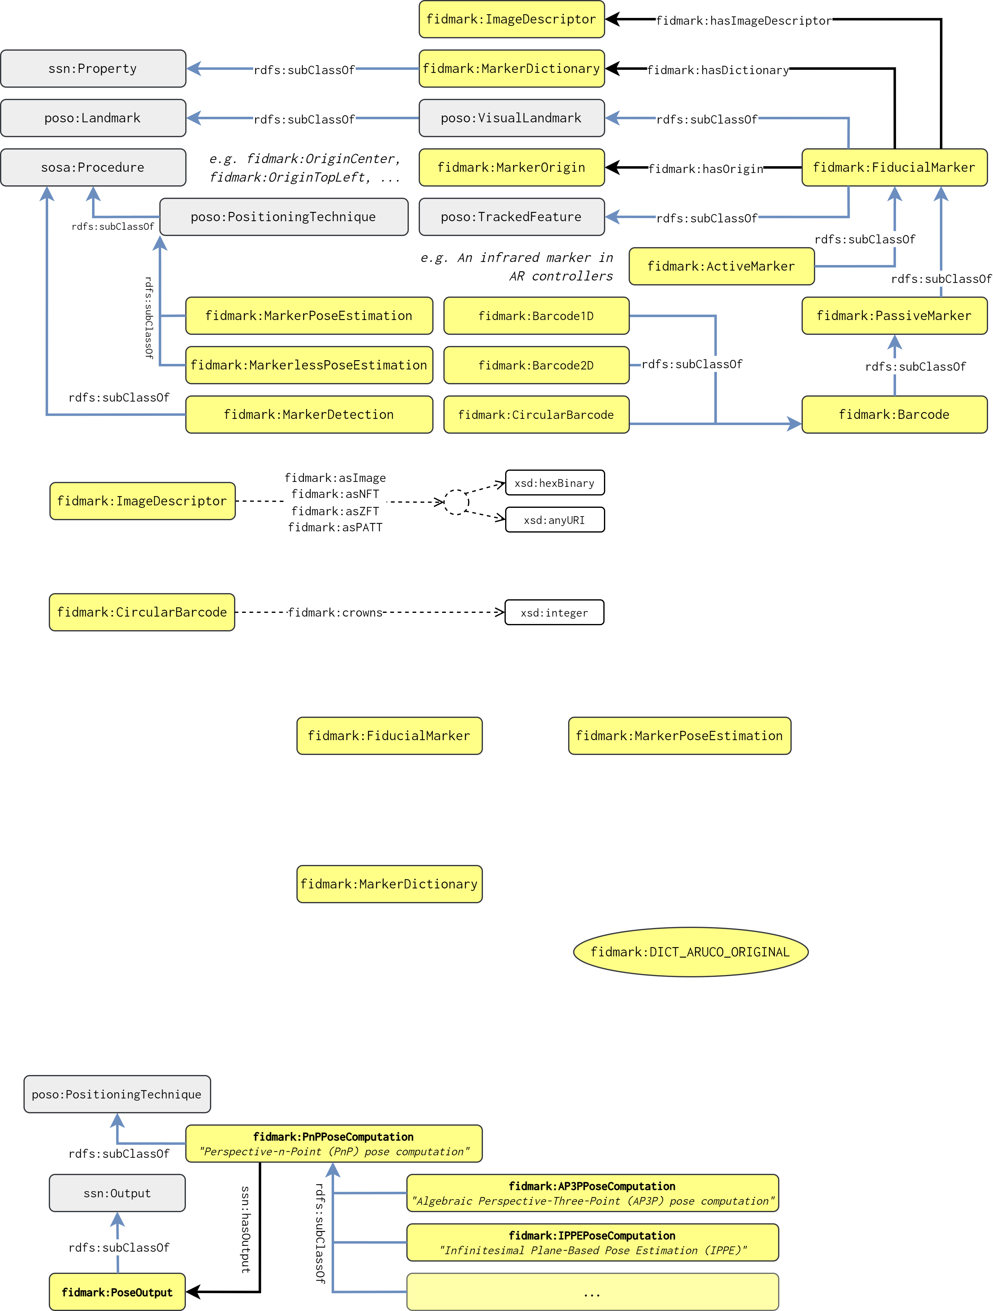
Ontology Design

Slide 6
Ontology Design

Slide 7
Validation
OOPS! Validator (OntOlogy Pitfall Scanner)
SPARQL queries for design goals
Demonstrator Web application

Slide 8
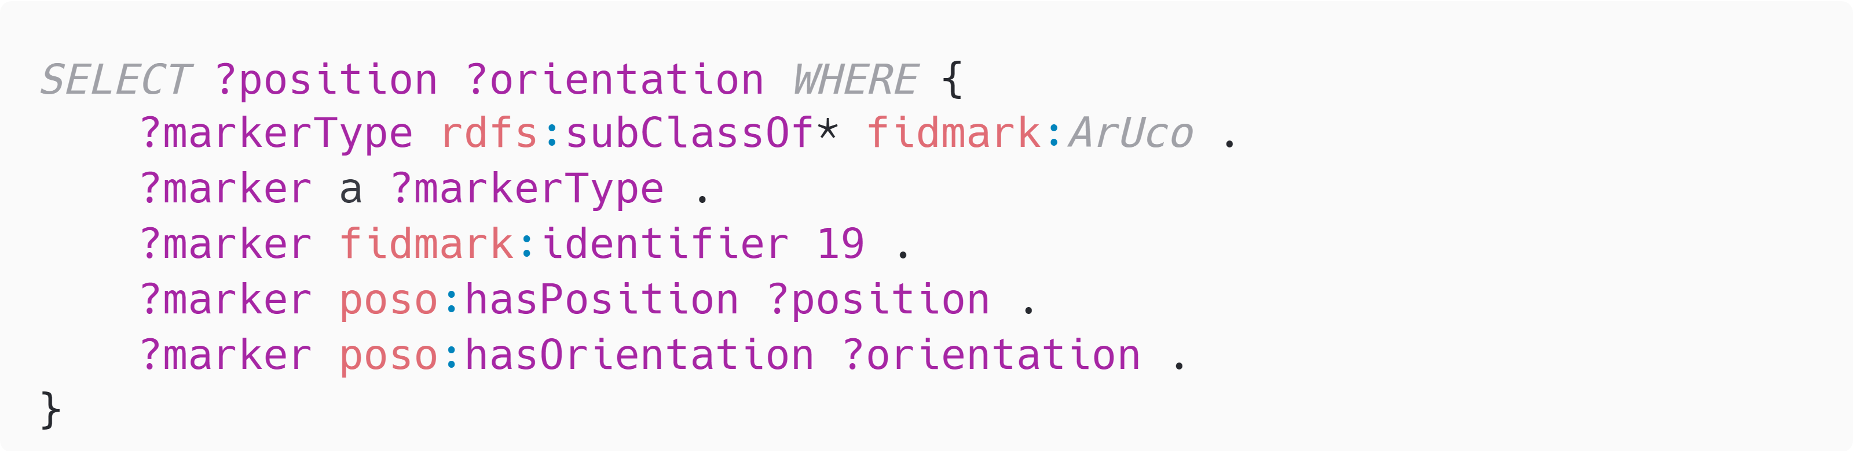
Validation – SPARQL queries
Get the position and orientation of a detected marker
(i.e. an ArUco marker with ID 19)

Slide 9
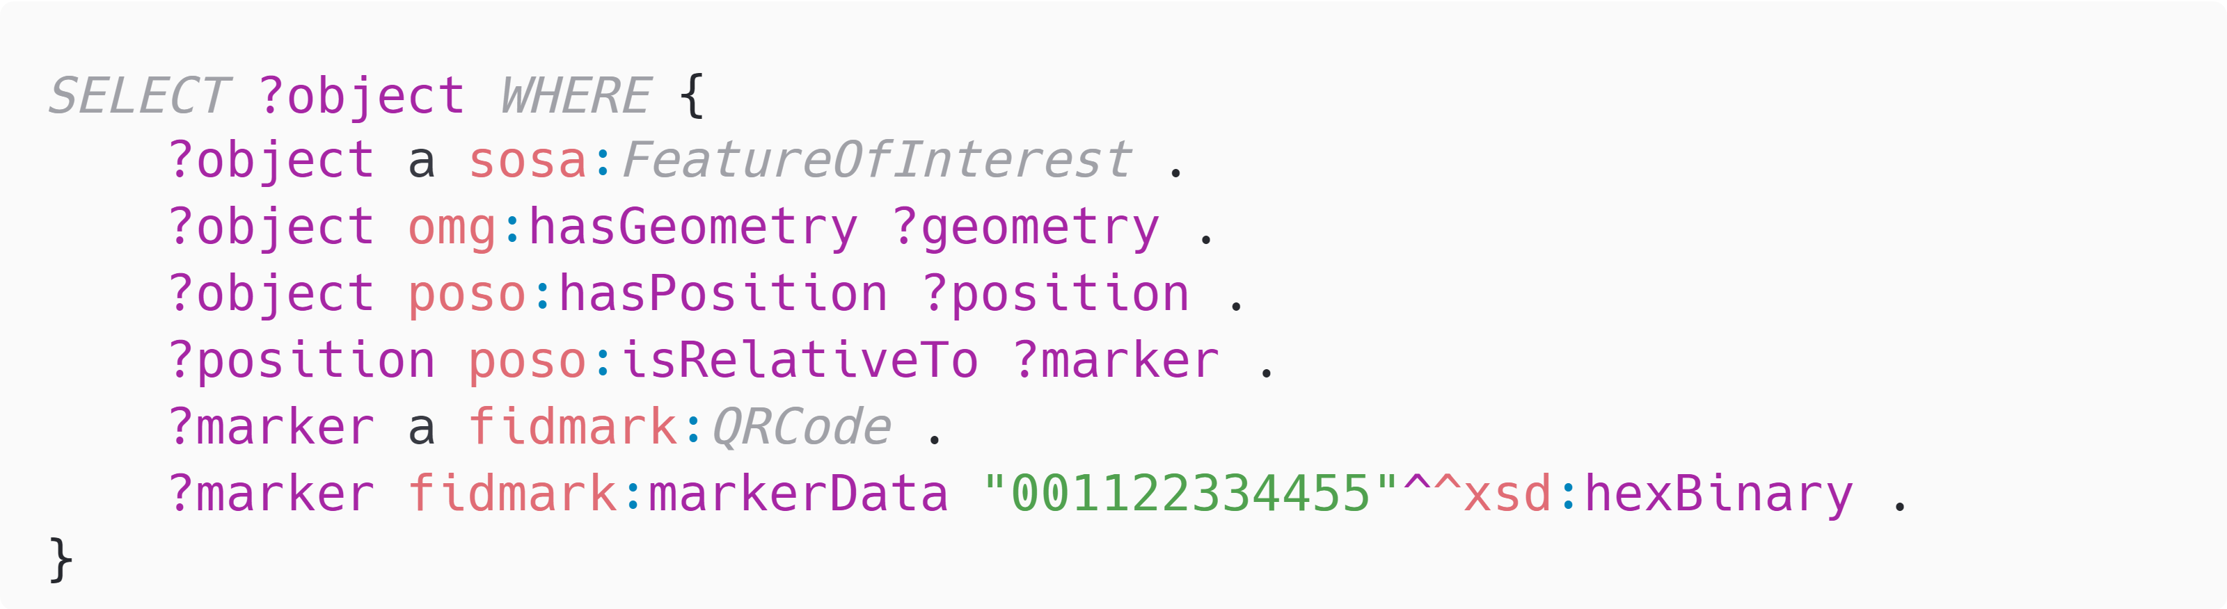
Validation – SPARQL queries
Get all virtual objects placed relative to a QR-code marker
with the data 0x001122334455

Slide 10
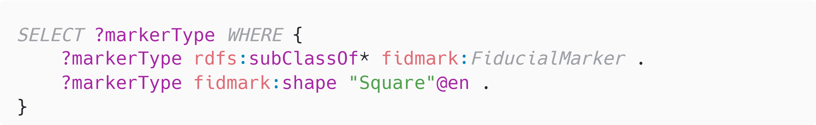
Validation – SPARQL queries
Select all square fiducial marker types

Slide 11
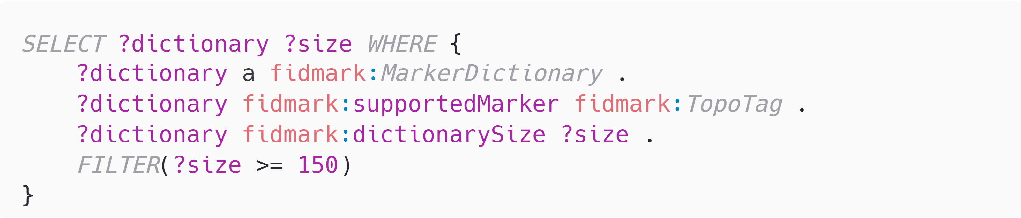
Validation – SPARQL queries
Find all dictionaries and the count of markers that can be identified in this dictionary for the marker type “TopoTag”. Ensure that at least 150 markers can be identified.

Slide 12
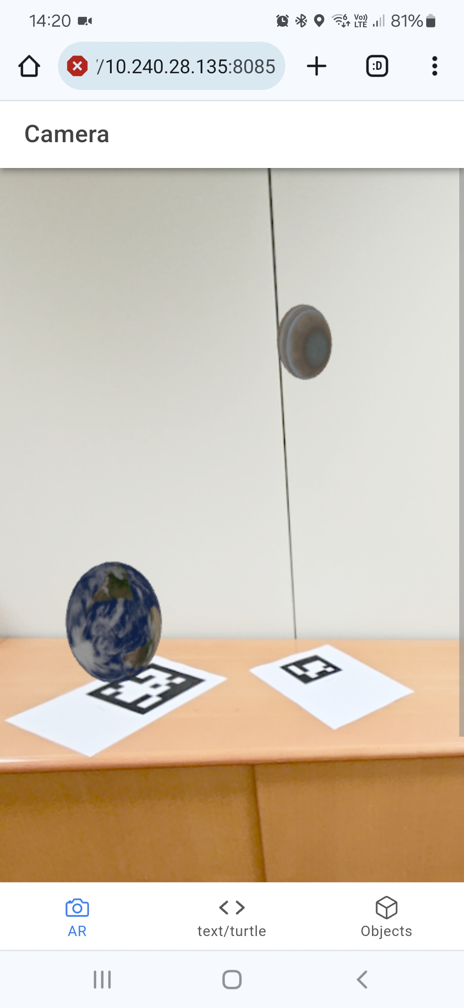
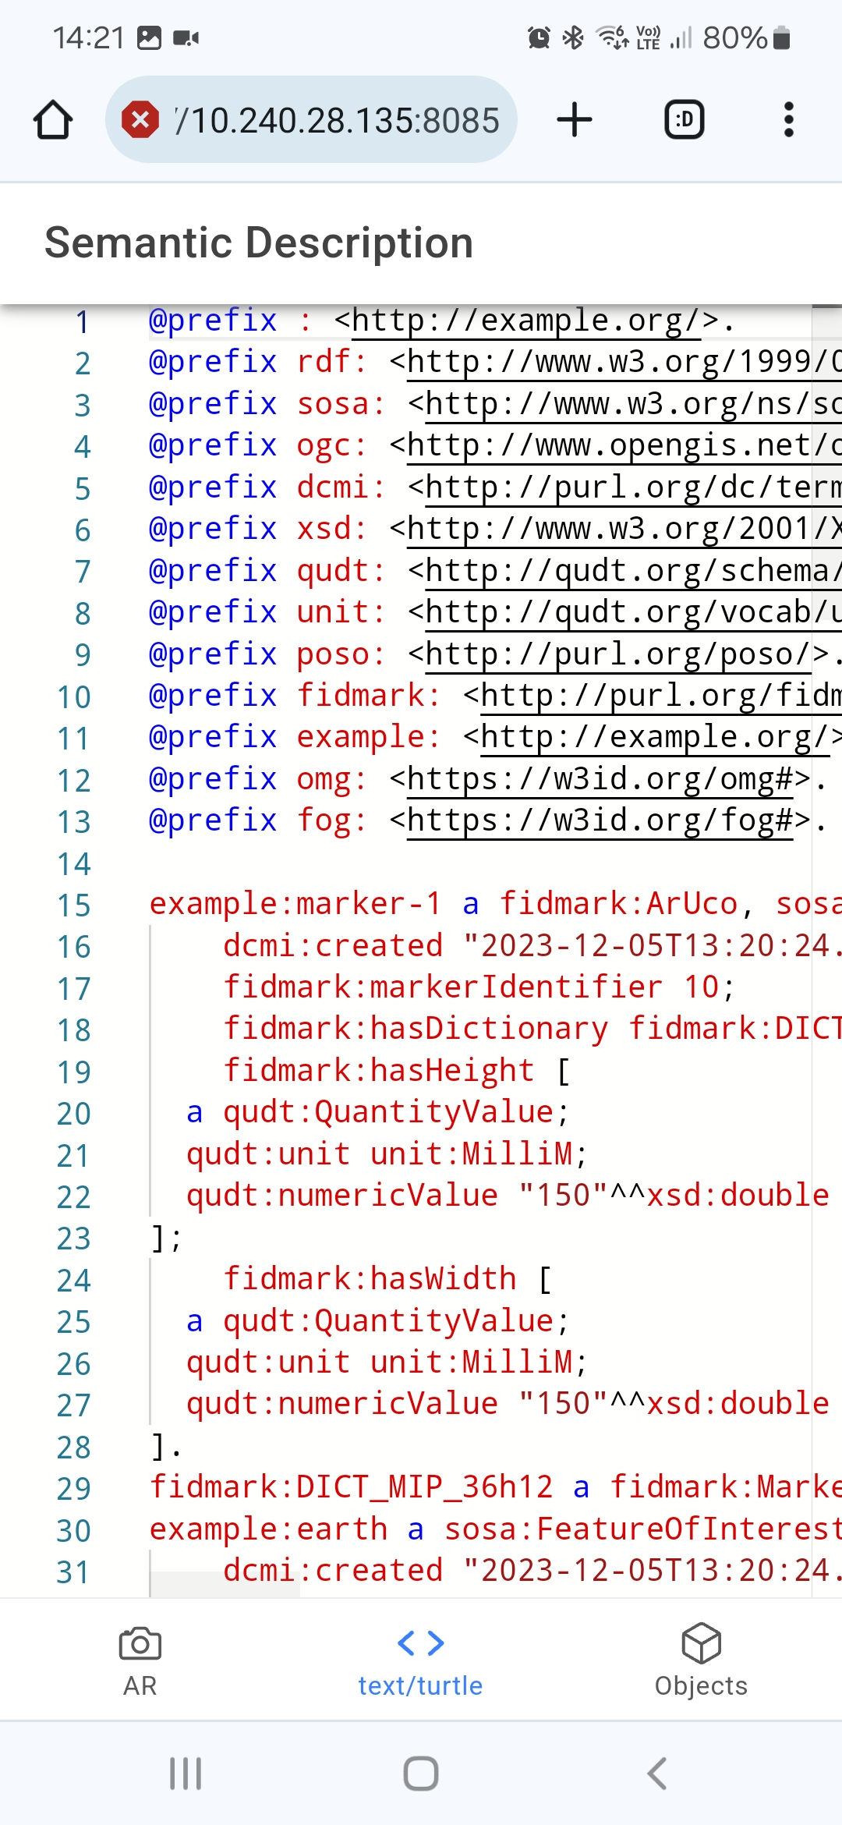
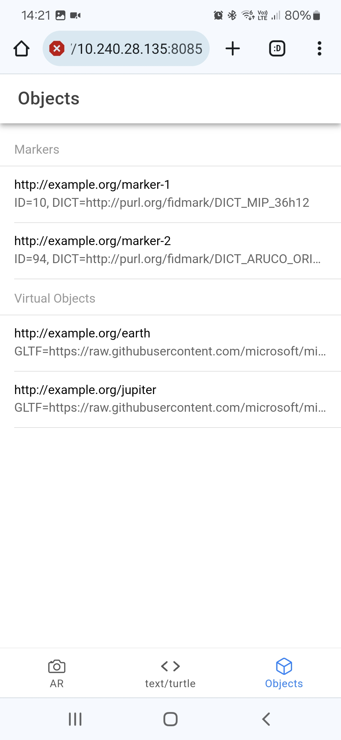
Demonstrator
Notes:
The demonstrator we have developed as part of this ontology is to demonstrate a basic example in which a marker can and should be described for it to be used in an augmented reality application.

Slide 13
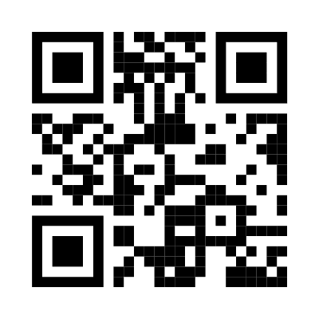


Conclusions and Future Work
Fiducial marker ontology with a focus on Augmented Reality
Demonstrator application
https://purl.org/fidmark/
https://fidmark.openhps.org/
https://github.com/OpenHPS/FidMark/

